Slide 1
WELCOME

Slide 2
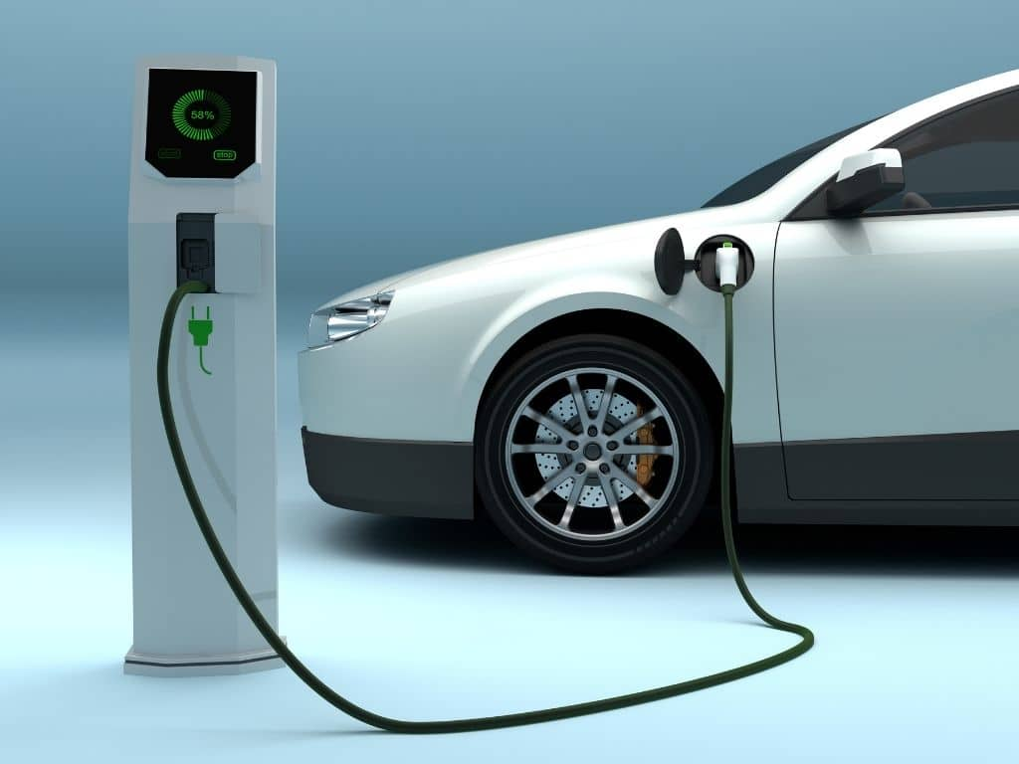
VISUALIZATION TOOL FOR ELECTRIC VEHICLE CHARGE AND RANGE ANALYSIS

Slide 3
TEAM MEMBERS
TEAM LEADER : P.NIVETHITHA
TEAM MEMBERS : R.SIVASANKARI
E.BHUVANESWARI
B.SUBIKSHA

Slide 4
INTRODUCTION
A vehicle that can be powered by an electric motor that draws electricity from a battery and is capable of being charged from an external source and have an electric motor instead of an internal combustion engine.
The Electric Vehicle (EV) is not new, but it has been receiving significantly more attention in recent years. Advances in both EV analytics and battery technologies have led to increased automotive market share. However, this growth is not attributed to hardware alone. The modern mechatronic vehicle marries electrical storage and propulsion systems with electronic sensors, controls, and actuators, integrated closely with software, secure data transfer, and data analysis, to form a comprehensive transportation solution. Advances in all these areas have contributed to the overall rise of EV’s, but the common thread that runs through all these elements is data analytics.

Slide 5
EMPATHY MAP

Slide 6
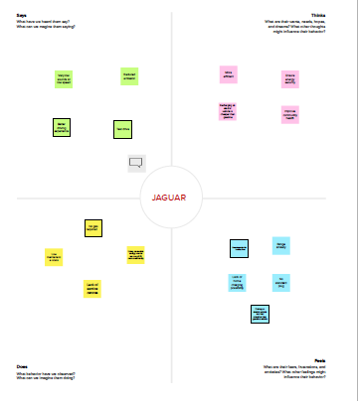

Slide 7
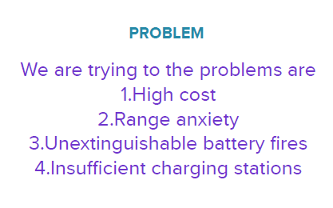
DEFINING PROBLEM

Slide 8
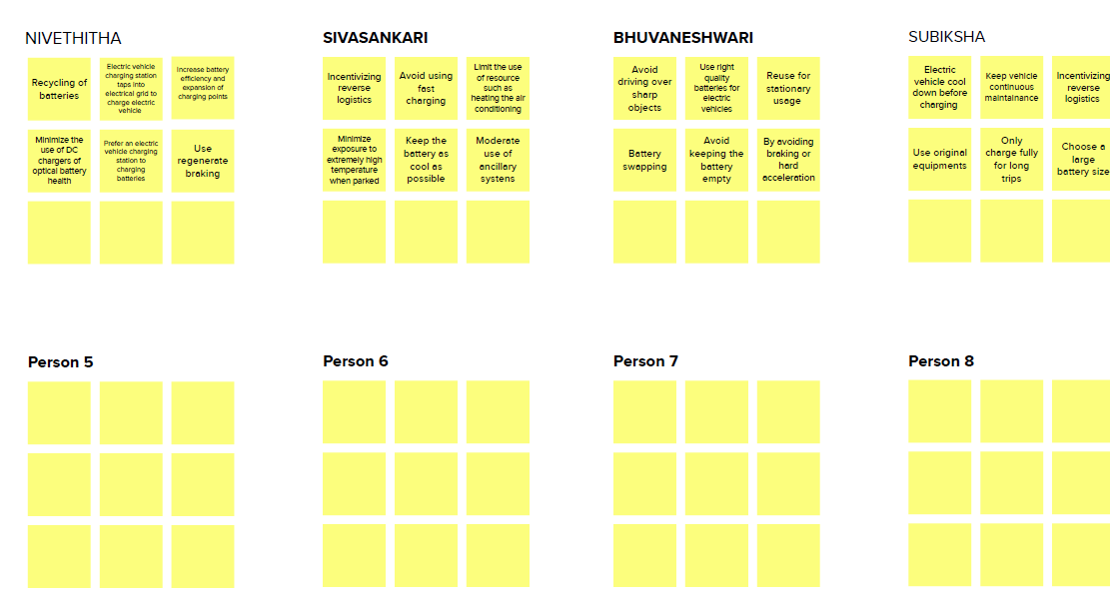
BRAINSTORM

Slide 9
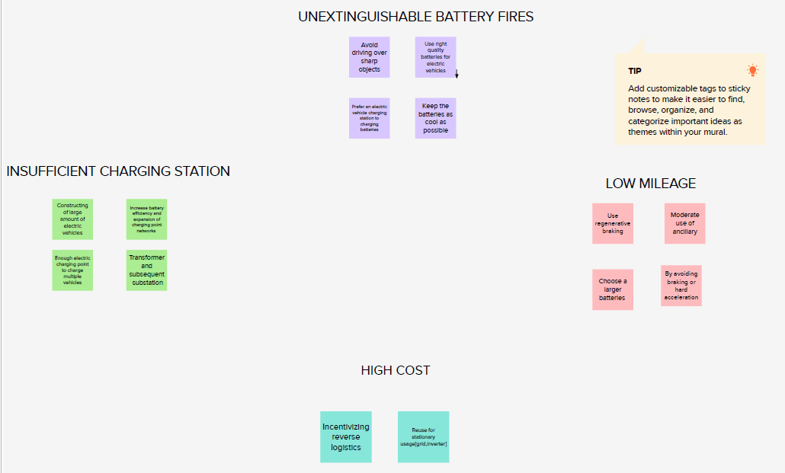
GROUP IDEAS

Slide 10
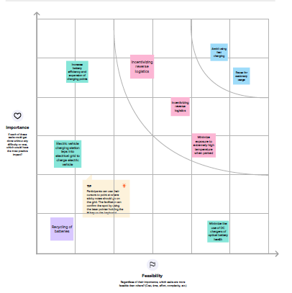
PRIORITIZE

Slide 11
NUMBER OF VISUALIZATION
1.Charging stations by region and type in India
2.EV charging stations map of India
3.Different EV cars in India
4.Top speed for different brands
5.Price for different cars in India
6.Top 10 most efficient EV brands
7.Brands according to body styles
8.Brand filtered by powertrain type
9.Number of models in each brand
10.Summary card for different brands of EV cars in globally
11.Summary card for different brands of EV cars in India

Slide 12
DASHBOARD
A dashboard is a graphical user interface (GUI) that displays information and data in an organized, easy-to-read format. Dashboards are often used to provide real-time monitoring and analysis of data, and are typically designed for a specific purpose or use case. Dashboards can be used in a variety of settings, such as business, finance, manufacturing, healthcare, and many other industries.
They can be used to track key performance indicators (KPIs), monitor performance metrics, and display data in the form of charts, graphs, and tables.

Slide 13
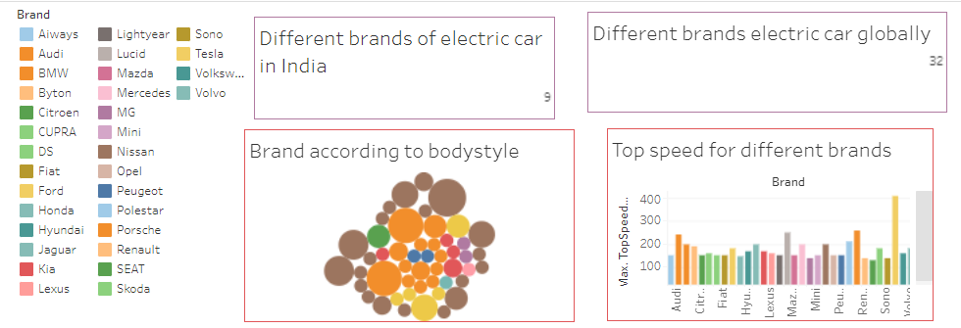

Slide 14
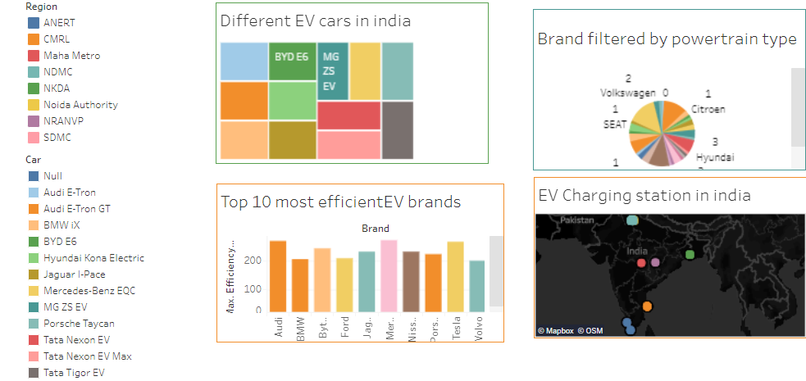

Slide 15
STORY
A data story is a way of presenting data and analysis in a narrative format, with the goal of making the information more engaging and easier to understand. A data story typically includes a clear introduction that sets the stage and explains the context for the data, a body that presents the data and analysis in a logical and systematic way, and a conclusion that summarizes the key findings and highlights their implications. Data stories can be told using a variety of mediums, such as reports, presentations, interactive visualizations, and videos.

Slide 16
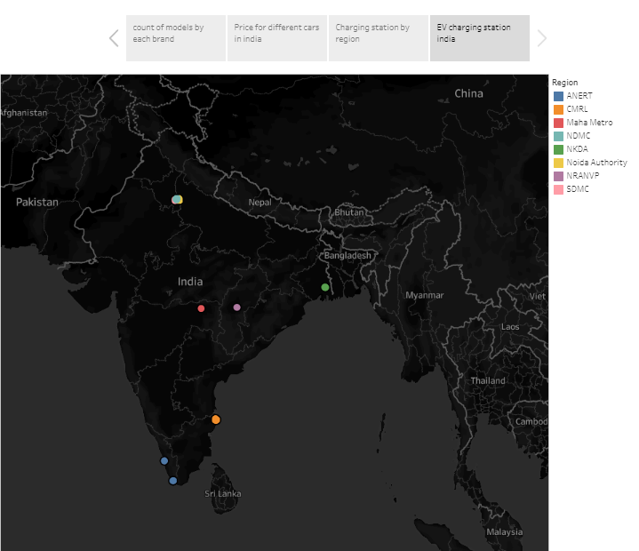

Slide 17
THANK YOU

